Slide 1
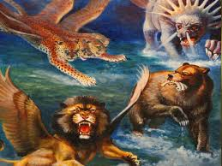
MONSTERS, THREATS AND GOD’S PROMISE TO YOU

Slide 2
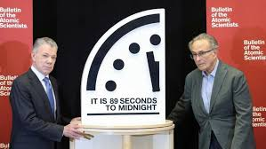
With threats of nuclear war, climate change and AI misuse, scientists have set the doomsday clock closer to midnight and human extinction than it has ever been.

Slide 3
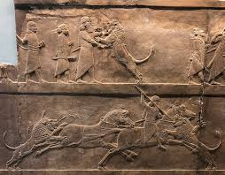

Slide 4
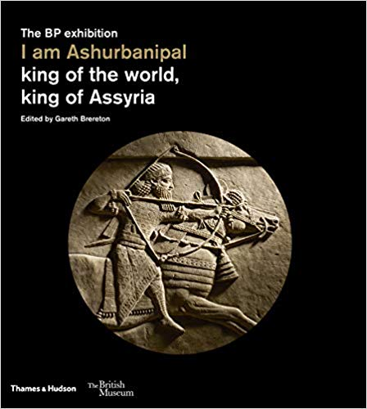

Slide 5
For the king of Babylon will stop at the fork in the road, at the junction of the two roads, to seek an omen: He will cast lots with arrows, he will consult his idols, he will examine the liver.
Ezekiel 21:21

Slide 6
There is a man in your kingdom in whom is the Spirit of the Holy God. And in the days of your father, light and understanding and wisdom, like the wisdom of the gods, were found in him; and King Nebuchadnezzar your father—your father the king—made him chief of the magicians, astrologers, Chaldeans, and soothsayers. Inasmuch as an excellent spirit, knowledge, understanding, interpreting dreams, solving riddles, and explaining enigmas were found in this Daniel, whom the king named Belteshazzar, now let Daniel be called, and he will give the interpretation.”
Daniel 5:11-12

Slide 7
This was the dream. Now we will tell the king its interpretation. You, O king, the king of kings, to whom the God of heaven has given the kingdom, the power, and the might, and the glory, and into whose hand he has given, wherever they dwell, the children of man, the beasts of the field, and the birds of the heavens, making you rule over them all—you are ⁻ the head of gold. Daniel 2:36-38
The tree you saw, which grew large and strong, with its top touching the sky, visible to the whole earth, with beautiful leaves and abundant fruit, providing food for all, giving shelter to the wild animals, and having nesting places in its branches for the birds— Your Majesty, you are that tree! You have become great and strong; your greatness has grown until it reaches the sky, and your dominion extends to distant parts of the earth.
Daniel 4:20-22

Slide 8
In the first year of Belshazzar king of Babylon, Daniel saw a dream and visions of his head as he lay in his bed. Then he wrote down the dream and told the sum of the matter.
Daniel 7:1
And you Belshazzar, have not humbled your heart, but you have lifted up yourself against the Lord of heaven. The God in whose hand is your breath, and whose are all your ways, you have not honoured. Daniel 5:22,23 (selected)

Slide 9
I saw in the night visions, and behold, with the clouds of heaven there came one like a son of man, and he came to the Ancient of Days and was presented before him. And to him was given dominion and glory and a kingdom, that all peoples, nations, and languages should serve him; his dominion is an everlasting dominion, which shall not pass away, and his kingdom one that shall not be destroyed.
Daniel 7:13,14
But the saints of the Most High shall receive the kingdom and possess the kingdom forever, forever and ever.’
Daniel 7:18
And the kingdom and the dominion and the greatness of the kingdoms under the whole eaven shall be given to the people of the saints of the Most High; his kingdom shall be an everlasting kingdom, and all dominions shall serve and obey him.
Daniel 7:27

Slide 10
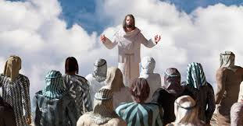
“Fear not, little flock, for it is your Father’s
good pleasure to give you the kingdom.
Luke 12:32

